Slide 1
COURSE PROJECT
IMAGE TRANSLATION FROM ENGLISH TO KANNADA
PES1201701655 Shamitha. S
PES1201701156 Astha Singh

Slide 2
Introduction :
Image translation refers to a technology where we can translate the text on images (posters, banners, menu list, sign board, document, screenshot etc.).
This is done by pre-processing of the image followed by segmentation to extract the text contained in the image and then translating the text into a language of choice.

Slide 3
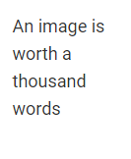
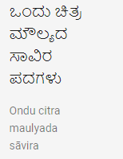
Problem Statement
To read text written in English from an Image and translating it into Kannada language.

Slide 4
INPUT IMAGE
METHODOLOGY
PRE-PROCESSING
CONERT TO BINARY
TRANSLATED TEXT
HORIZONTAL SEGMENTATION
VERTICAL SEGMENTATION
WEB TRANSLATER
TEMPLATE MATCHING
STORING THE TEXT

Slide 5
Implementation:
Pre-processing:
The aim of pre-processing is an improvement of the image data that suppresses all the unwanted distortions and enhances some image features important for further processing.

Slide 6
RGB Input Image
Grey Scale Image
Thresholding Function
Pre-processed Image
Area opening process
Binary Image

Slide 7
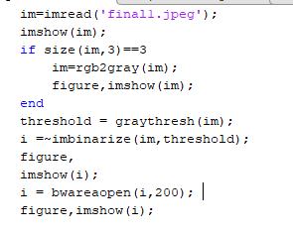
Pre-Processing Code:

Slide 8




Pre-Processing Output

Slide 9
Segmentation:
Segmentation is an important process in image recognition, its referred to the isolation of the position of the words within the image, and then the extraction of each letter individually.
1: Horizontal segmentation
2: Vertical segmentation

Slide 10
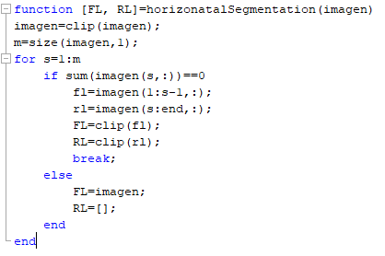



Horizontal Segmentation

Slide 11
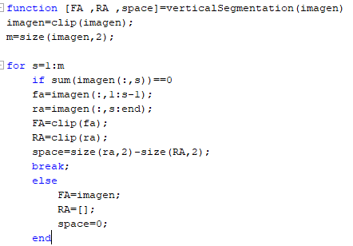


Vertical Segmentation

Slide 12
Correlation
The segmented image is resized to the size of the template provided and correlated with the template image using matlab function corr2. This is stored in an array. After this we find the index value and if the index value matches to the condition a new text file is created and the letters are written in the file.

Slide 13
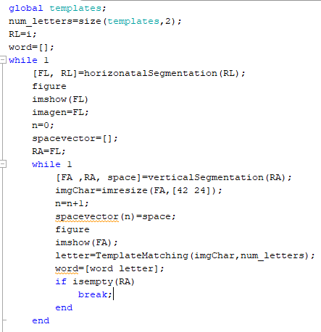
Correlation Code

Slide 14
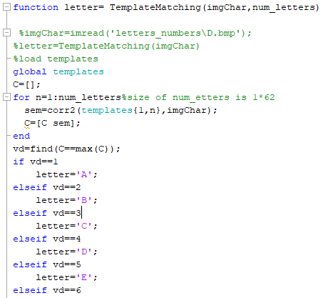
Template Matching

Slide 15
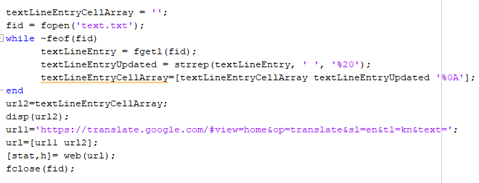
Translating

Slide 16
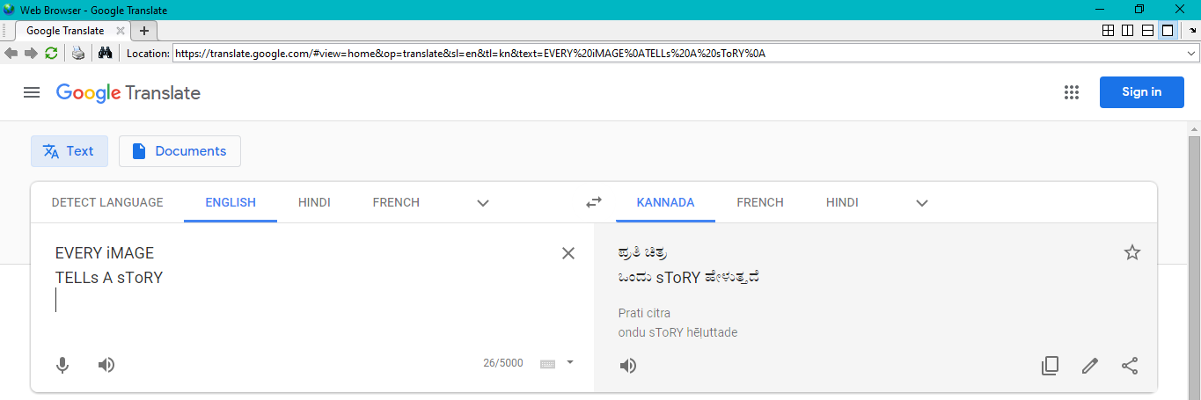
FINAL OUTPUT

Slide 17
Conclusion and further enhancements
This code works for fonts which is similar to the given template.
It can be further enhanced by using neural network instead of correlation where the handwritten dataset is provided and training, testing is performed on that dataset.
This can also be implemented using OCR inbuilt function of matlab.

Slide 18
References
https://www.mathworks.com/help/images/translate-an-image.html
https://circuitdigest.com/tutorial/vehicle-number-plate-detection-using-matlab-and-image-processing
https://ijireeice.com/wp-content/uploads/2013/03/IJIREEICE3G-a-ragini-RECOGNITION-OF-VEHICLE-NUMBER-PLATE-USING-MATLAB.pdf

Slide 19
THANK YOU

